Slide 1
Machine Learning in Business John C. Hull
Chapter 7
Reinforcement Learning

Slide 2
Reinforcement Learning
Reinforcement learning is concerned with finding a strategy for taking a series of decisions rather than just one
The environment is usually changing unpredictably

Slide 3
Rewards and costs
There are rewards and costs and the algorithm tries to maximize expected rewards (net of costs) in its interaction with the environment
Exploitation vs. Exploration (Should you choose best decision based on evidence to date or try something new?)
Action evaluated by the sum of expected rewards (net of costs) that come after it (possibly discounted)

Slide 4
A Simple example: K-armed bandits
This is like a one-armed bandit except that you have to choose between K levers.
Lever k provides a return from a normal distribution with mean m_{k} and standard deviation 1
Objective is to maximize return over a large number of trials

Slide 5
Strategy
You keep records of the average return from choosing each lever
At each turn you have to decide between
Choose the lever that has given you the best average return so far (the “greedy action”)
Try out a new action
The first choice is exploitation; the second is exploration.
We can choose a parameter ε equal to the probability of exploration
Exploitation maximizes the immediate expected return but exploration may do better in the long run

Slide 6
The Math (page 149)
Suppose that lever k has been chosen n−1 times and the total reward on the jth time it is chosen is R_{j}
Expected reward is
If kth lever is chosen for the nth time and produces a reward R_{n}

Slide 7
Example: Table 7.1, 4 bandits (m₁=1.2, m₂=1, m₃=0.8, m₄=1.4); ε = 0.1

Slide 8
When ε = 0.01 (Table 7.2)

Slide 9
When ε = 0.5 (Table 7.3)

Slide 10
The exploration parameter ε and initial values
It makes sense to reduce ε over time. For example we can let it decline exponentially
The initial Q-values make a difference. For example if they all set equal to 2 instead of 0 there would be early exploration
If the standard deviation of the payoff is increased, a higher value of ε would be appropriate

Slide 11
ε starts at 1 but has a decay factor of 0.995

Slide 12
The More General Model: Actions and States (Figure 7.1)
Initial State
Action Taken time 0
Reward time 1 State time 1
Action Taken time 1
S₀
A₀
R₁
S₁
A₁
A₃
R₃
S₃
A₂
R₂
S₂
Action Taken time 3
Reward time 3
State time 3
Action Taken time 2
Reward time 2
State time 2

Slide 13
Objective
Objective could be to maximize the expected value of rewards
G=R₁+R₂+R₃+……+R_{T}
In some cases, particularly when there is a long or infinite horizon, the objective is to maximize the expected value of discounted rewards:
G=R₁+ γ R₂+ γ²R₃+……..
where γ is a discount factor

Slide 14
Updating
Define Q(S,A) as the value of being in state S and taking action A
Suppose we have just completed the nth trial for state S and action A. Instead of
we usually set
for some parameter α (e.g. 0.1)

Slide 15
A Simple Example: the game of Nim
There is a pile of N matches. Two players take it in turns to pick up one, two, or three matches.
Last player to pick up loses
State is the number of matches. Action is number picked up. Reward occurs at the end (=+1 if you win and -1 if you lose)
What is the optimal strategy?
We can work back from the end of the game.
What if it is your turn and there are 2, 3, 4, 5, 6,… matches?

Slide 16
Using Monte Carlo
This works similarly to the 4-armed bandit example
In that example we had 4 actions
Here we consider state-action combinations
Define Q(S,A) as the value of being in state S when action A is taken
We might initially set all the Q(S,A) to zero
We simulate a set of actions

Slide 17
Using Monte Carlo continued
There is a chance (1-ε) that we choose the best action so far for any given state and ε that we randomly choose an action
Define G as the total reward (possibly with discounting) for the complete set of actions taken in one trial
For each {S,A} combination that is encountered on the trial we update as follows

Slide 18
Nim with 8 matches in the pile initially
Here are the initial values for the state/action combinations
Matches picked up | State (=number of matches left )
 | 2 | 3 | 4 | 5 | 6 | 7 | 8
1 | 0 | 0 | 0 | 0 | 0 | 0 | 0
2 | 0 | 0 | 0 | 0 | 0 | 0 | 0
3 |  | 0 | 0 | 0 | 0 | 0 | 0

Slide 19
Nim continued
Opponent behaves randomly
Reward for winning is 1; reward for losing is −1
The matches picked up on first simulation (with opponent’s choice in brackets) is
1,[3],1,[3] (win)
We assign a gain, G, of 1 to:
state 8, action 1
state 4, action 1
and apply updating formula, setting α = 0.05

Slide 20
Nim after one trial (1,[3],1,[3])
Matches picked up | State (=number of matches left )
 | 2 | 3 | 4 | 5 | 6 | 7 | 8
1 | 0 | 0 | 0.05 | 0 | 0 | 0 | 0.05
2 | 0 | 0 | 0 | 0 | 0 | 0 | 0
3 |  | 0 | 0 | 0 | 0 | 0 | 0

Slide 21
Next trials
Matches picked up | State (=number of matches left )
 | 2 | 3 | 4 | 5 | 6 | 7 | 8
1 | 0 | 0 | 0.05 | -0.05 | 0 | 0 | -0.025
2 | 0 | 0 | 0 | 0 | 0 | 0 | 0
3 |  | 0 | 0 | 0 | 0 | 0 | 0
Second trial
1,[2],1,[3],1 (lose)

Slide 22
Example of convergence, ε=0.1 (Tables 7.8 to 7.10)
After 1000 trials
After 5,000 trials
After 25,000 trials

Slide 23
Dynamic Programming
Simple sequential decision problems can be solved by dynamic programming where we work back from the end to the beginning calculating the optimal action in each state. The recursion formula for the value V(S) of being in state S is
An alternative to Monte Carlo simulation is temporal difference learning which uses the ideas underlying dynamic programming

Slide 24
Temporal difference learning
Instead of using G (the total, possibly discounted, future rewards) to update, we can use the current value at the next step. The updating formula becomes
where V is the current estimate of the value of being in the state reached at the end the next step. If S* is this state, V is the current maximum value of Q(S*,A) across all actions A that can be taken in the state.
This is referred to a Q-learning

Slide 25
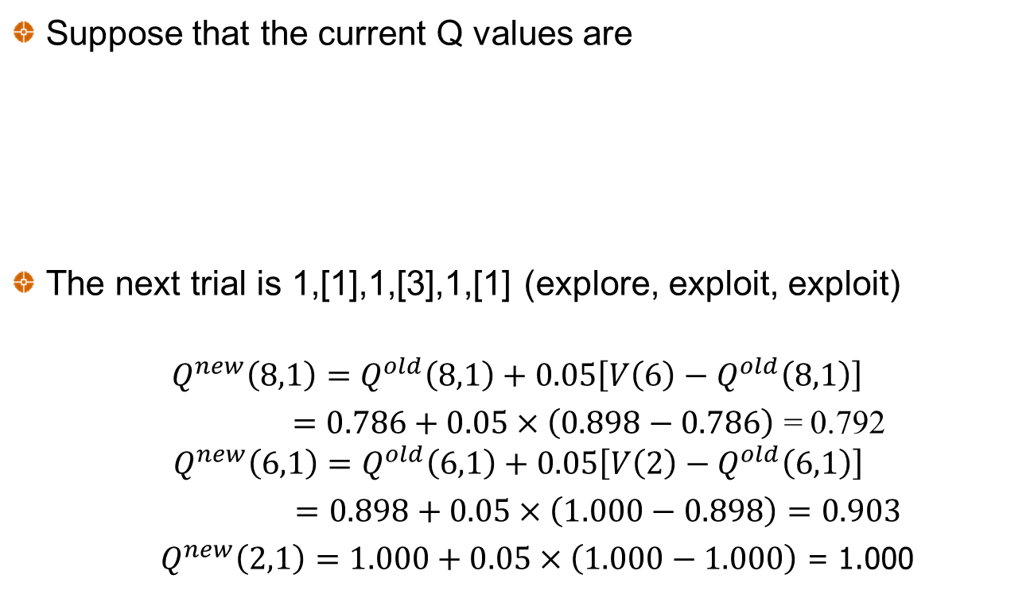
Example (page 158-159)
Suppose that the current Q values are
The next trial is 1,[1],1,[3],1,[1] (explore, exploit, exploit)
$$Q^{new}\left(8,1\right)=Q^{old}\left(8,1\right)+0.05\left[V\left(6\right)−Q^{old}\left(8,1\right)\right]$$
$=0.786+0.05×\left(0.898−0.786\right)$ = 0.792 $Q^{new}\left(6,1\right)=Q^{old}\left(6,1\right)+0.05\left[V\left(2\right)−Q^{old}\left(6,1\right)\right]$
$=0.898+0.05×\left(1.000−0.898\right)=0.903$
$Q^{new}\left(2,1\right)=1.000+0.05×\left(1.000−1.000\right)$ = 1.000

Slide 26
n-step bootstrapping
Monte Carlo bases updates on what happens over the complete life of the trial
Temporal difference bases updates on what happens over the next period
n-step bootstrapping algorithms is between the two. It bases updates on what happens over the next n periods

Slide 27
When there are many states or actions (or both)
The cells of the state/action table do not get filled in very quickly
It becomes necessary to estimate the Q(S,A) function from observed values.
As this function is in general non-linear a natural approach is to use artificial neural networks (ANNs).
We use an ANN to minimize the sum of squared errors between the estimates and the target
This is known as deep Q-learning or deep reinforcement learning

Slide 28
Applications
Games such as Go and chess
Driverless cars
Programming of traffic lights
Healthcare
Finance applications
Optimally selling a large block of shares
Portfolio management where there are transaction costs
Hedging

